Slide 1

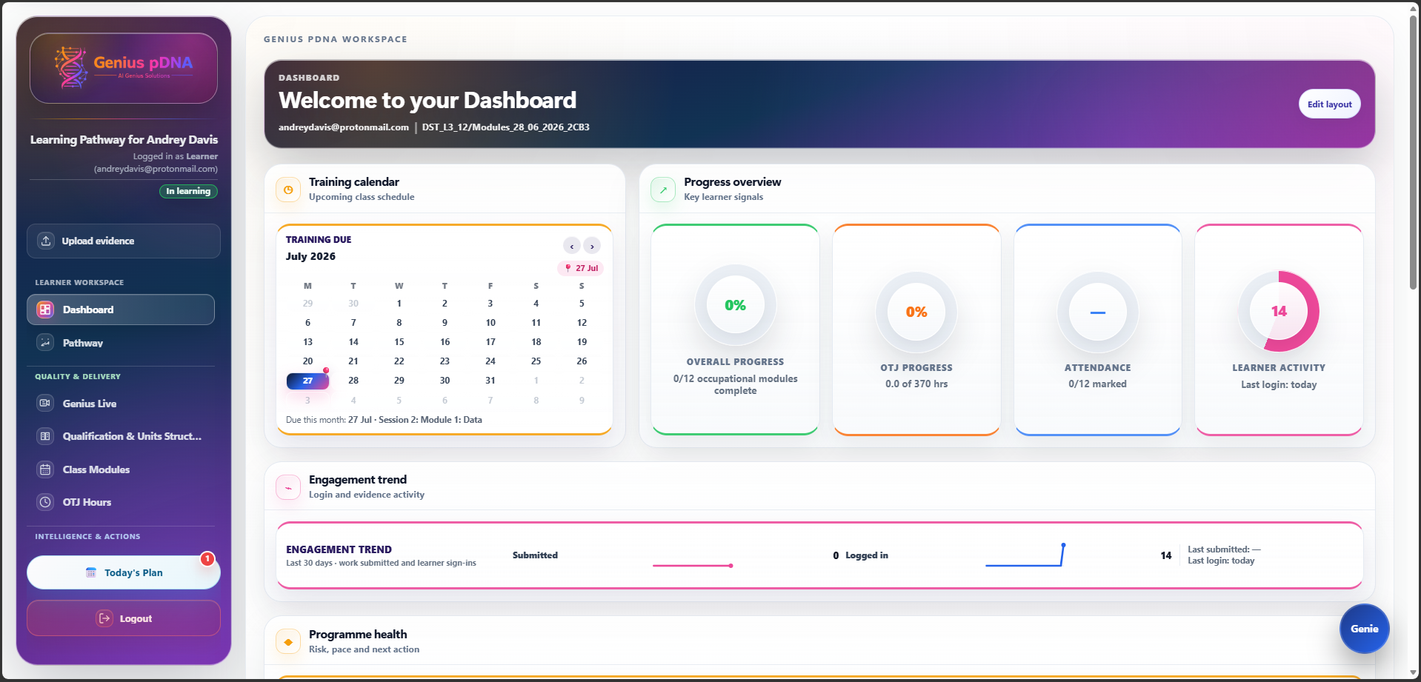
The intelligent operating system for apprenticeship delivery.
One connected learner record for pathways, delivery, evidence, OTJ, employer engagement, quality, compliance and explainable action.
One connected platform
Personalised Pathway and operational Class Modules
Training Plans, OTJ, attendance, evidence and reviews
Evidence Graph, Journey Autopilot and Genie Actions
Employer Cockpit, IQA, qualifications, reports and audit history
Genius Live video meetings, mobile access and offline-capable workflows
Less administration
Earlier intervention
Protect investment
Faster competence
Information entered once supports connected delivery and reporting.
Risk and evidence gaps become visible sooner.
OTJ, evidence, reviews and employer action remain traceable.
Clear priorities focus effort where it creates value.
See where Genius pDNA could reduce cost and strengthen delivery.
BOOK A DEMO
andreydavis@aigeniussolutions.com · 07375 424 513 · geniuspdna.com
AI Genius Solutions Ltd · Company Reg: 16774347

