Slide 1

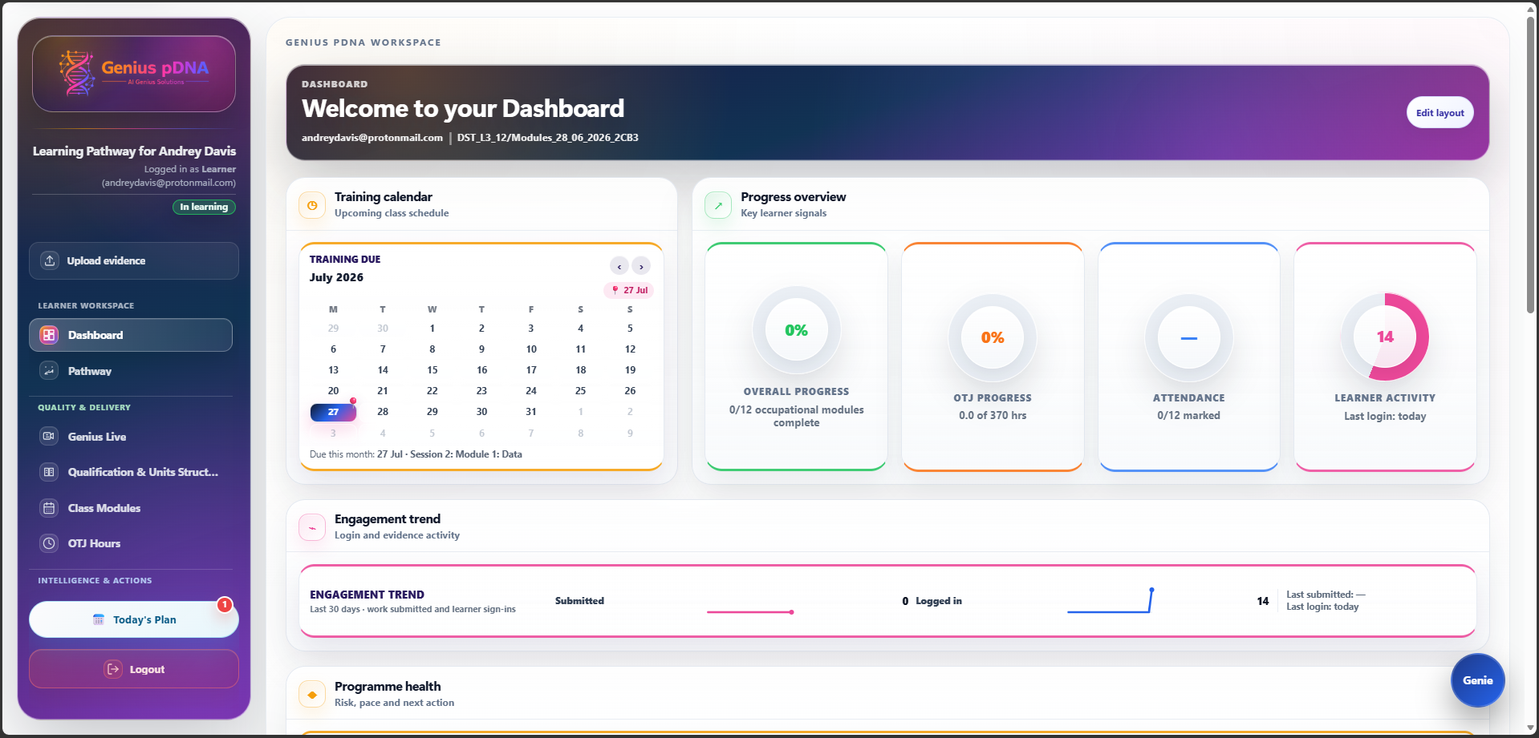
COMMERCIAL OVERVIEW
The intelligent operating system for apprenticeship delivery.
Connected pathways, delivery, evidence, OTJ, employer engagement, quality, compliance and explainable action - all around one live learner record.
One connected learner record
AI Genius Solutions Ltd
geniuspdna.com

Slide 2
COMMERCIAL VALUE
What organisations need - and where current systems create cost.
Modern apprenticeship delivery needs one reliable record, earlier visibility of risk and clearer ownership across provider, employer and learner.
WHAT ORGANISATIONS WANT
COMMON PLATFORM FRICTION
GENIUS pDNA RESPONSE
One dependable learner record
Clear ownership and next actions
Early warning before risk becomes delay
Fast, credible reporting and oversight
Separate plans, trackers and folders
Repeated entry and manual reconciliation
Risks spotted too late
Employer information too limited or too complex
Connected Pathway, Class Modules, OTJ and evidence
Evidence Graph, Autopilot and Genie Actions
Employer Cockpit and IQA workspaces
Reports and audit history from the same record
AI Genius Solutions Ltd · Genius pDNA · 2026
02

Slide 3
ONE CONNECTED PLATFORM
A live operating layer for apprenticeship delivery.
Genius pDNA links the learner journey, operational delivery, employer involvement, intelligence, quality and compliance instead of asking teams to rebuild the story in separate tools.
01
02
03
One learner record
Explainable intelligence
Employer and quality oversight
Pathway, Training Plan, Class Modules, OTJ, evidence, attendance, reviews, qualifications and compliance remain connected.
Evidence Graph, Journey Autopilot and Genie Actions surface what matters next while professional judgement remains in control.
Employer Cockpit, IQA, reports and audit history provide focused oversight without duplicating the record.
Configure → Add learner → Personalise → Deliver and evidence → Act and assure
AI Genius Solutions Ltd · Genius pDNA · 2026
03

Slide 4
DELIVERY PLANNING
Pathway and Class Modules turn the programme into an operational plan.
The agreed standard and delivery model become a chronological learner route and a practical delivery timetable.
PATHWAY
CLASS MODULES
A personalised chronological route.
The operational timetable for delivery.
Programme modules, reviews, Functional Skills and wellbeing activity in sequence
Delivery windows, module targets and responsibility across provider, employer and apprentice
Current, upcoming and completed learning presented clearly to each role
Training Plan and OTJ allocation remain aligned with the same delivery logic
Learner and cohort views with chronological session ordering
Centre, live remote, provider-guided and self-study delivery modes
Attendance, session detail, delivery ownership and timing in context
Group delivery optimisation without losing learner-specific requirements
Planning remains connected to what actually happens: attendance, evidence, OTJ, reviews and quality activity update the same learner record.
AI Genius Solutions Ltd · Genius pDNA · 2026
04

Slide 5
INTELLIGENCE & ACTION
Live information becomes visible, prioritised action.
The platform connects the record, exposes the relationships that matter and presents explainable next steps without replacing professional judgement.
PW
Pathway
CM
Class Modules
EG
Evidence Graph
AP
Autopilot
Personalised learning route
Operational delivery timetable
Evidence and KSB relationships
Prioritised operational actions
GA
Genie Actions
EC
Employer Cockpit
IQ
IQA & Quality
QU
Qualifications & Units
Explainable role-aware guidance
Focused workplace oversight
Sampling and assurance
Units, RPL and evidence
PLAN
→
DELIVER
→
EVIDENCE
→
ACT
→
ASSURE
AI Genius Solutions Ltd · Genius pDNA · 2026
05

Slide 6
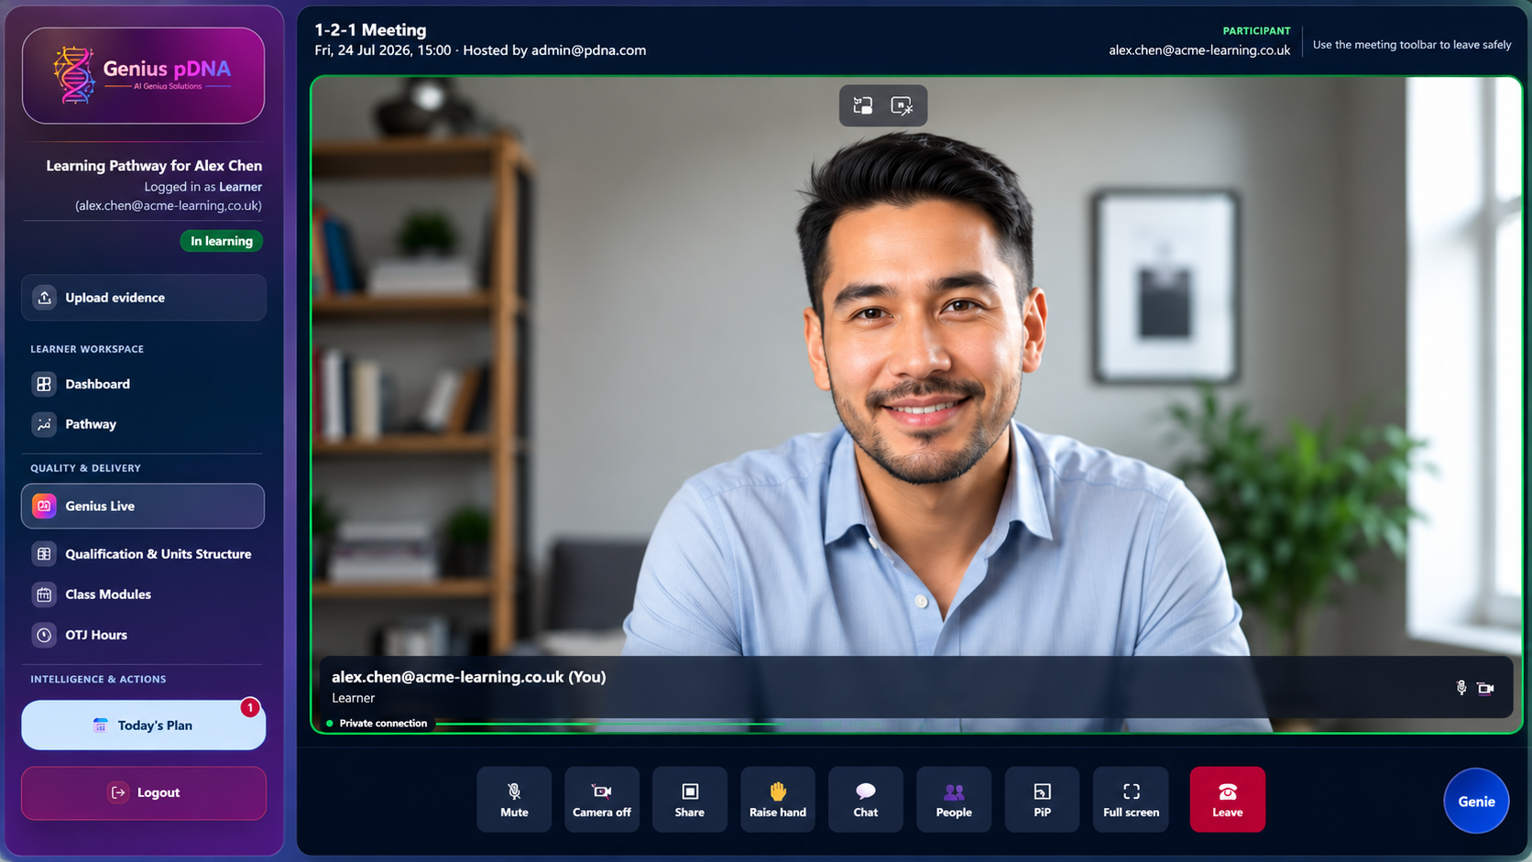
CONNECTED EXPERIENCE
Desktop, mobile, Genius Live and offline-capable work stay linked.
Users can move between the web platform, installed experience and live meetings without splitting the learner story across separate systems.
Genius Live
Embedded 1-to-1 reviews, remote delivery, screen sharing, chat, participants and picture-in-picture.
Desktop & mobile access
Responsive web, installable PWA, direct installation and native distribution routes.
Offline & synchronisation
Selected workflows can continue with limited connectivity and synchronise back to the same record.
AI Genius Solutions Ltd · Genius pDNA · 2026
06

Slide 7
LEARNER WORKSPACE
A personal view of progress, delivery and next steps.
Learners see the information they need without being shown provider-only operational complexity.
LEARNER
Training calendar and upcoming activity
Personalised Pathway and Class Modules
Progress, OTJ, attendance and learner activity
Evidence upload, reviews and Training Plan access
Genius Live and role-relevant next actions
One clear place to understand what is happening now, what is coming next and what the learner needs to do.
AI Genius Solutions Ltd · Genius pDNA · 2026
07

Slide 8
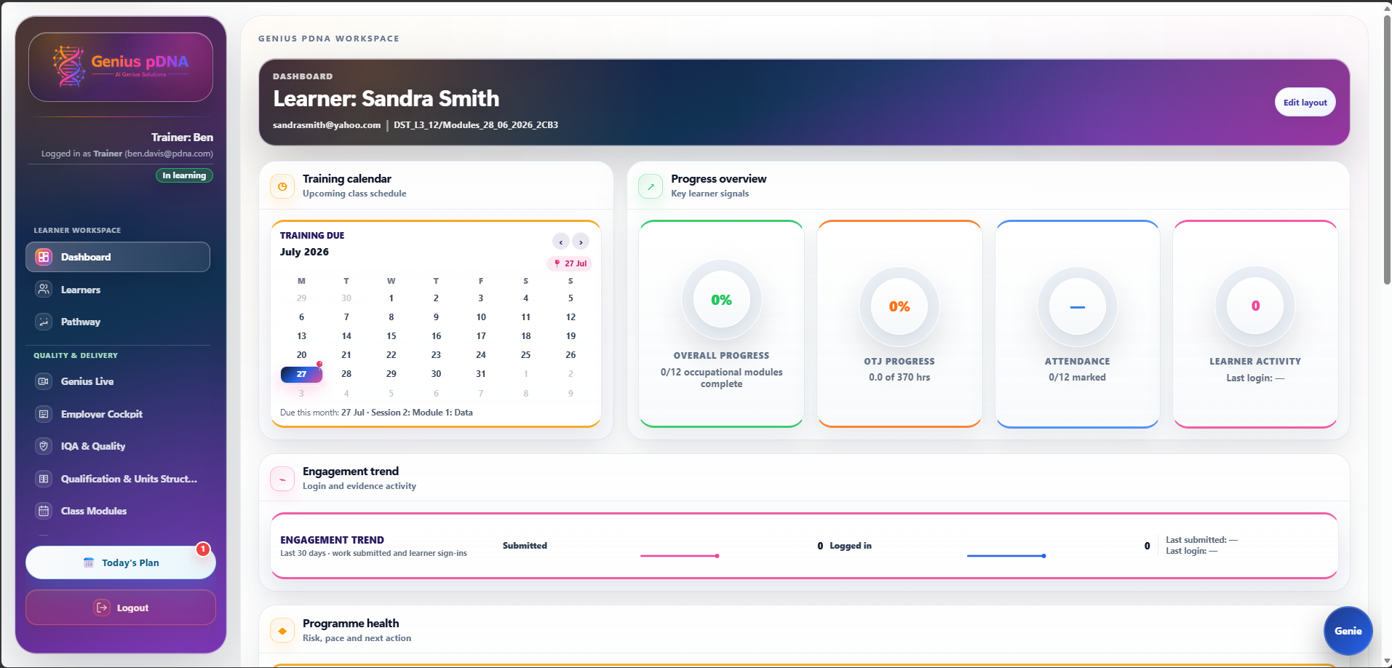
STAFF WORKSPACE
Operational visibility across learners, cohorts and delivery.
STAFF
Trainers, coaches, tutors, quality teams and administrators can move from risk signals into the relevant action and record.
Learner and cohort dashboards
Today’s Plan and upcoming delivery
Pathway, Training Plan and Class Modules
Evidence Graph, Autopilot and Genie Actions
IQA, compliance, analytics, reports and audit outputs
The same record supports operational delivery, quality assurance and leadership reporting.
AI Genius Solutions Ltd · Genius pDNA · 2026
08

Slide 9
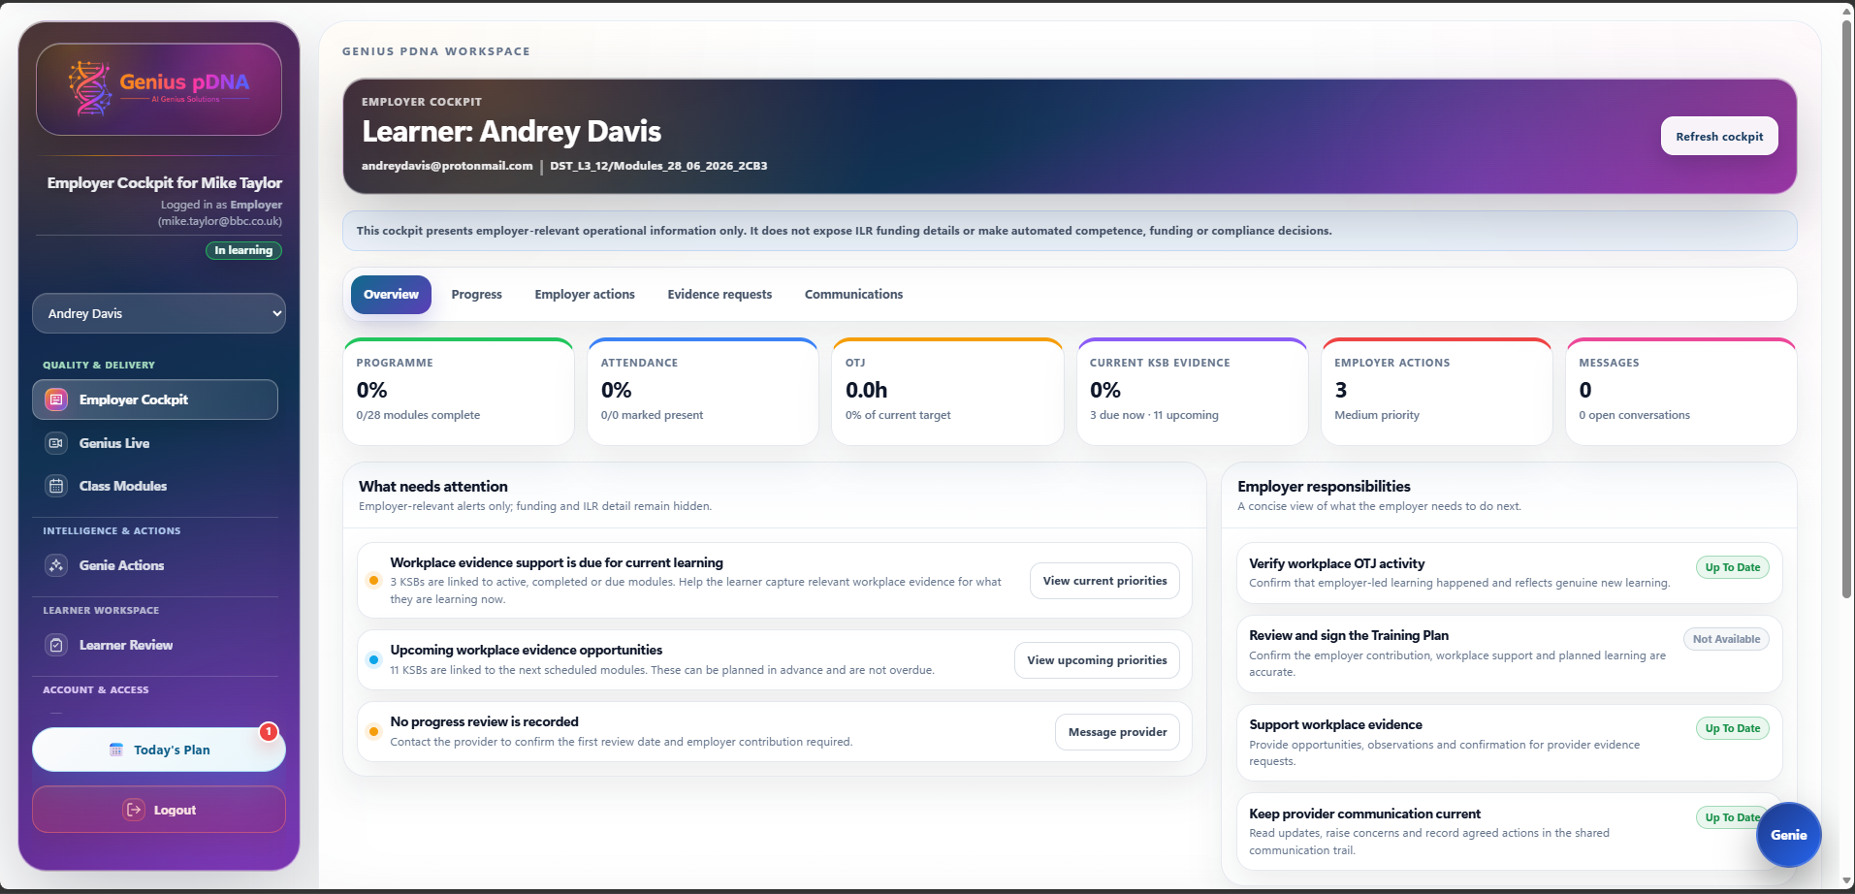
EMPLOYER WORKSPACE
Focused oversight without exposing provider-only complexity.
The Employer Cockpit presents the workplace information and responsibilities that matter to the employer.
EMPLOYER
Programme progress, attendance and OTJ
Current evidence position and workplace opportunities
Employer actions and responsibilities
Training Plan and review participation
Shared communication and traceable decisions
Employers receive a concise role-specific view rather than a copy of the staff interface.
AI Genius Solutions Ltd · Genius pDNA · 2026
09

Slide 10
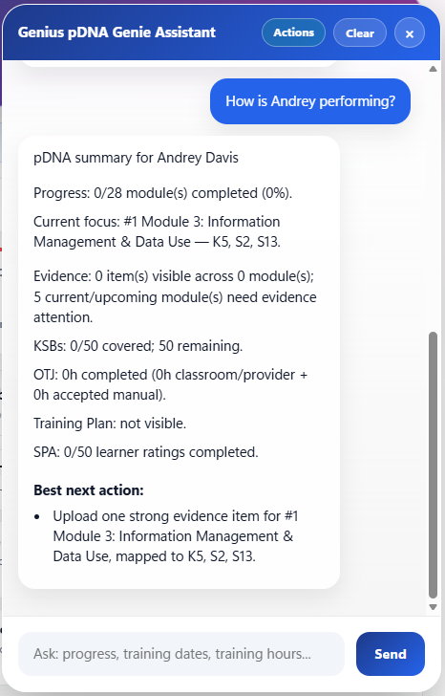
GENIE AI ASSISTANT
Ask the live record, understand the answer and act with confidence.
Genie works alongside Evidence Graph, Autopilot and role-aware actions. Recommendations remain explainable and subject to professional review.
01
02
Grounded answers
Explainable next actions
Summaries are based on the connected learner and programme record.
Users can understand why an issue matters and what action is suggested.
03
04
Role-aware context
Human control
Learner, trainer, coach, employer and quality users receive relevant guidance.
Recommendations are reviewable and do not replace professional judgement.
“How is this learner performing?”
“What should happen next?”
“Which evidence gaps matter?”
AI Genius Solutions Ltd · Genius pDNA · 2026
10

Slide 11
OUTCOMES & IMPLEMENTATION
Commercial value comes from connected processes, earlier action and better adoption.
A focused implementation aligns the platform to the organisation’s standards, delivery model, roles, data and reporting needs.
01
02
03
04
Less administration
Earlier intervention
Stronger investment protection
Faster route to competence
Information entered once supports connected plans, delivery, reviews, evidence, reports and actions.
Risk, inactivity, attendance and evidence gaps become visible before they become serious.
OTJ, evidence, reviews, employer activity and compliance remain traceable.
Clear priorities focus learner, employer and staff effort where it creates most value.
A practical route to adoption
1
Discovery and process mapping
2
Configuration and data preparation
3
Pilot with selected learners and roles
4
Training, rollout and review of outcomes
Commercial outcomes depend on programme scale, existing processes, implementation and adoption.
AI Genius Solutions Ltd · Genius pDNA · 2026
11

Slide 12
BOOK A FOCUSED DEMO
See where Genius pDNA could reduce cost and strengthen delivery.
AI Genius Solutions Ltd
andreydavis@aigeniussolutions.com
07375 424 513
A demonstration can focus on your learner journey, Pathway, Class Modules, Training Plans, OTJ, evidence, Genie, Genius Live, employer oversight, quality and likely areas of operational saving.
geniuspdna.com
Request a demo
Company Reg: 16774347
AI Genius Solutions Ltd · Genius pDNA · 2026
12

